Slide 1

Groq → DeepGram Aura Pipeline for a 2d First-Person Game
Exploring Image-to-Text and Text-to-Speech for Accessibility
By: Youssef Youssef
Professor: Yotam Gingold
Date: 03/12/2025

Slide 2

Objective
Develop a pipeline that extracts visual information and converts it into speech.
Utilize Groq for image-to-text analysis.
Use DeepGram Aura for text-to-speech narration.
Prototype and test before integrating into a full game.

Slide 3
Step 1 - Setting Up a Simple Scene Goal: Create a basic 2D first-person scene to mimic a 3D environment.
Tools:
Unity (C#) or Godot (GDScript)
Optional: Tiled for grid-based levels
Create a basic environment (corridor, room, obstacles).
Enable first-person movement.
Implement basic collision detection.
Implementation:

Slide 4
Step 2 - Extract Frames for Groq Processing. Why? Groq will analyze game frames and generate text descriptions.
Approach:
Capture frames at intervals (e.g., every 0.5s).
Convert frames into images (PNG, JPEG).
Send images to Groq for processing.
Frame Capture Methods:
Unity: ScreenCapture.CaptureScreenshot() or RenderTexture.
Godot: get_viewport().get_texture().get_data().

Slide 5
Step 3 - Convert Image to Text (Groq API)
Process:
Convert image to base64 format.
Send request to Groq API.
Receive text description (e.g., “A hallway with a door ahead.”).

Slide 6

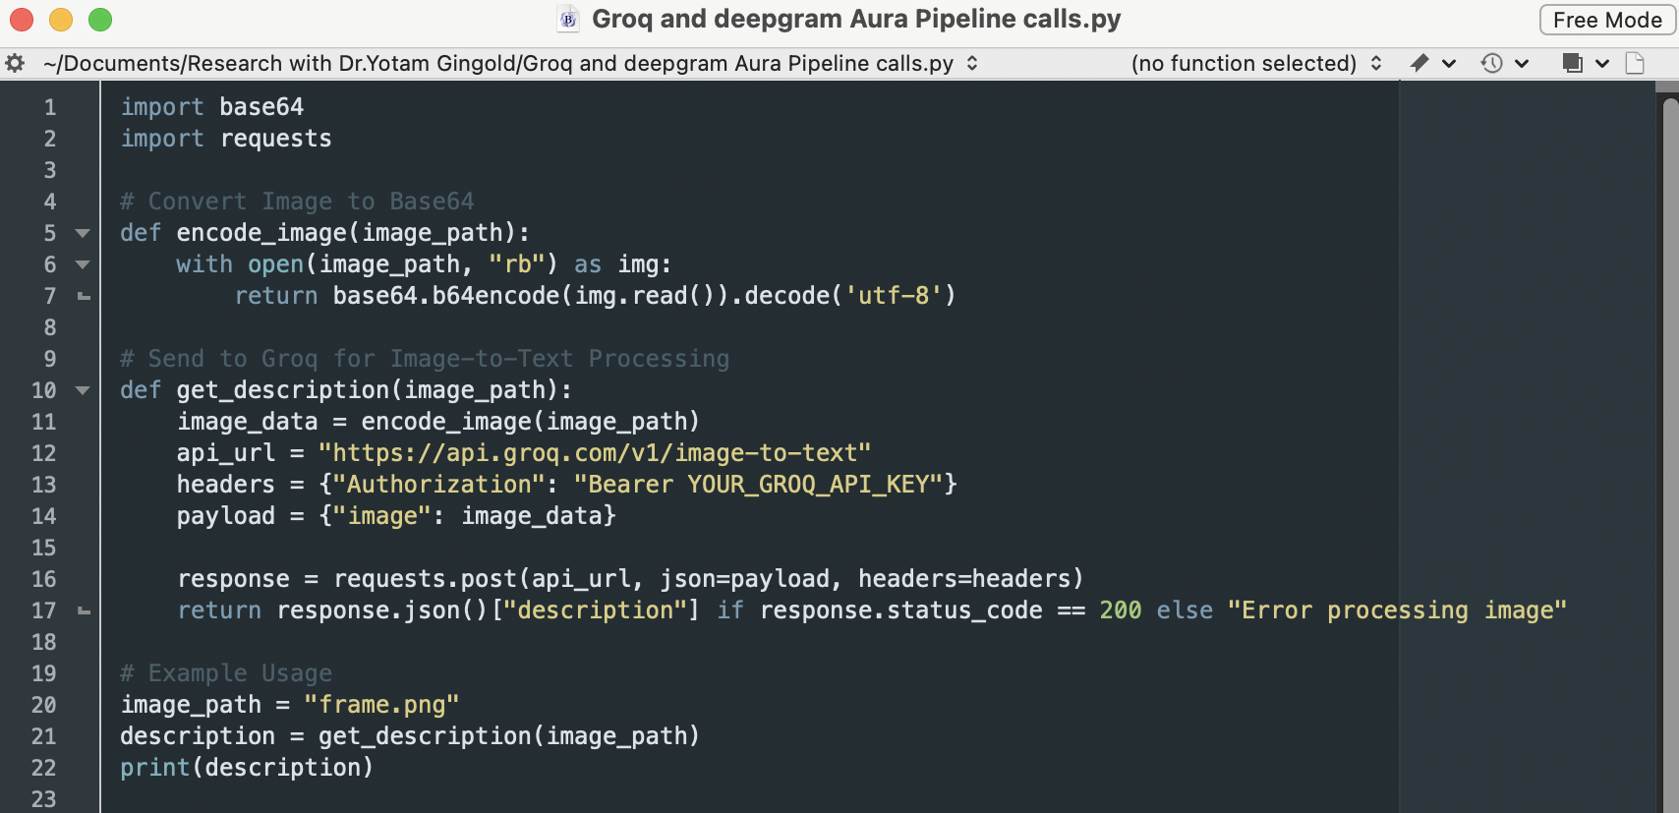
Example API Call (Python) By Chatgpt for groq:

Slide 7
Step 4 - Convert Text to Speech (DeepGram Aura)
Process:
Use DeepGram API to convert text to speech.
Play the generated audio in real-time.

Slide 8
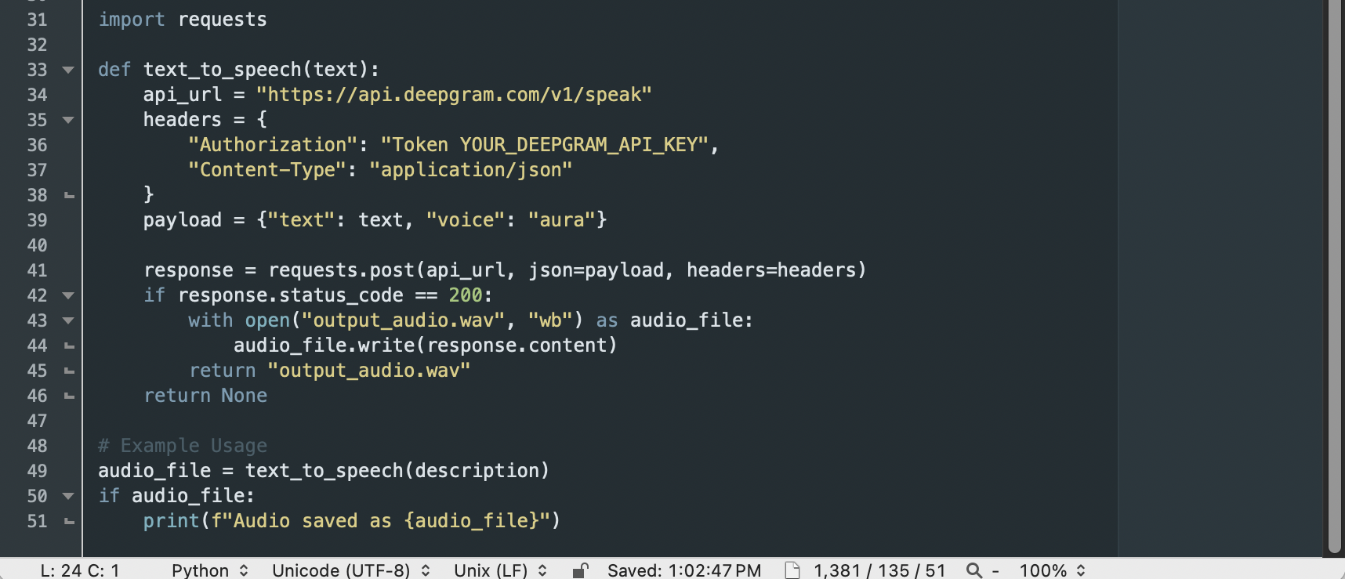
Example API Call (Python) By ChatGPT for Deepgram Aura:
Note: Playing Audio in Unity or Godot:
Unity: Use AudioSource.
Godot: Use AudioStreamPlayer.

Slide 9
Two Implementation Options
Option 1: Prototype with a Simple Scene (Test the Flow)
Goal: Ensure the pipeline works before integrating it into a game.
Steps:
  Generate video frames from a simple 2D first-person scene.
  Use Groq for image analysis.
  Convert text to speech with DeepGram Aura.
Output: A basic working pipeline describing a simple scene in real-time.
Pros:
  Faster to implement and debug.
  Confirms pipeline viability before adding complexity.

Slide 10
Two Implementation Options
Option 2: - Integrate with a First-Person Game Framework
Goal: Implement the pipeline directly into a game (e.g., The Stanley Parable).
Steps:
  Choose a game engine (Unity or Godot).
  Capture game frames in real time.
  Send frames to Groq.
  Convert text to speech with DeepGram Aura.
  Refine narration timing and interactions.
Pros:
  More practical for real-world use.
  Provides full interactivity.
Cons:
  More time-consuming.
  Debugging within a full game adds complexity.

Slide 11
Next Steps
Which Option Should We Do First?
I think: Start with Option 1 (Simple Scene) to confirm the pipeline.
If successful, move to Option 2 (Full Game Integration).

